Slide 1


PROJ302 INTERNSHIP POSTER
Barışcan Köse / 00025413
11.06.2021 – 13.08.2021
Machine Learning & Microprocessor Based System Design Internship at Ideaktif Danışmanlık & Yazılım Ltd. Şti.
Supervisor : Ibrahim Tekin
Sabancı University Electronics Engineering Program

Slide 2
L’Oreal Distributor SALDOS’ Trendyol Sales Numbers Prediction & Sensitivity Analysis
An e-commerce solutions provider company SALDOS, sells L’Oreal products at Trendyol in huge numbers.
They need a way to understand what factors influence the sales numbers so that they can purchase and advertise products more strategically.
The factors include :
Hour
Day
Month
Keyword Rank
Sales Price
Buybox status
Discount Rate
Product views

Slide 3
Methods & Tools
PowerBI Analysis and exporting of the data to an excel file
SQL and Python to keep the data in an SQL Server’s table
Pandas dataframe to hold all the data during machine learning modelling
Numpy array data format in order to feed the data to machine learning models
Scikit learn to normalize and preprocess the data
Tensorflow to create the deep neural network model, train & test the data
Matplotlib and Seaborn to display the prediction and accuracy results from which SALDOS can predict how much a product would sell at any time with multiple varying criterias

Slide 4
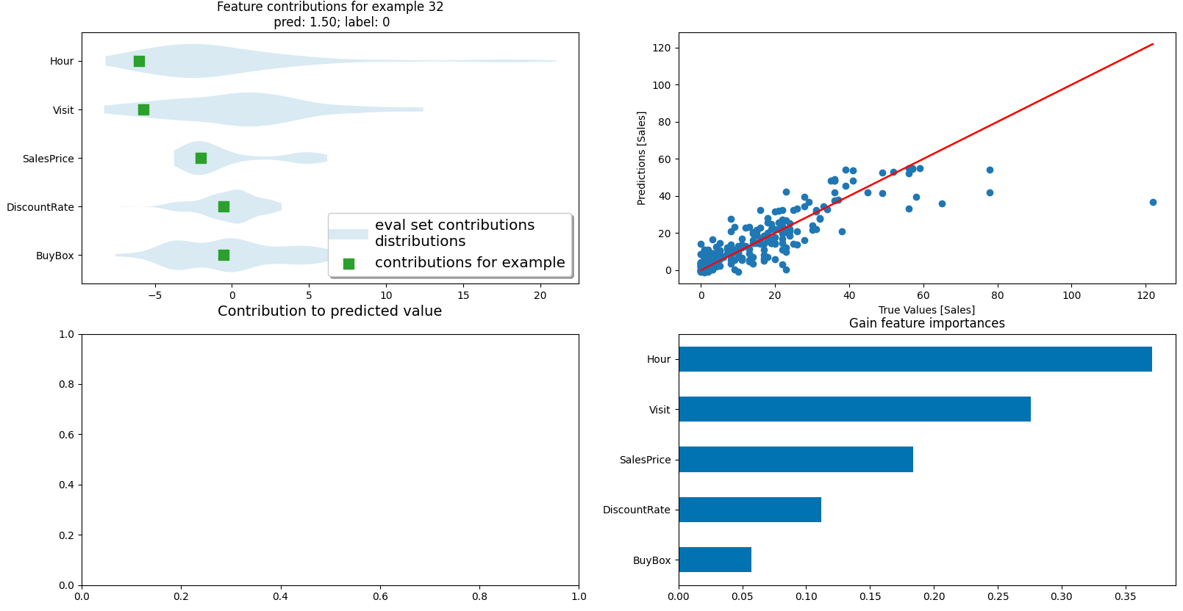
Training the Data & Sensitivity Analysis

Slide 5
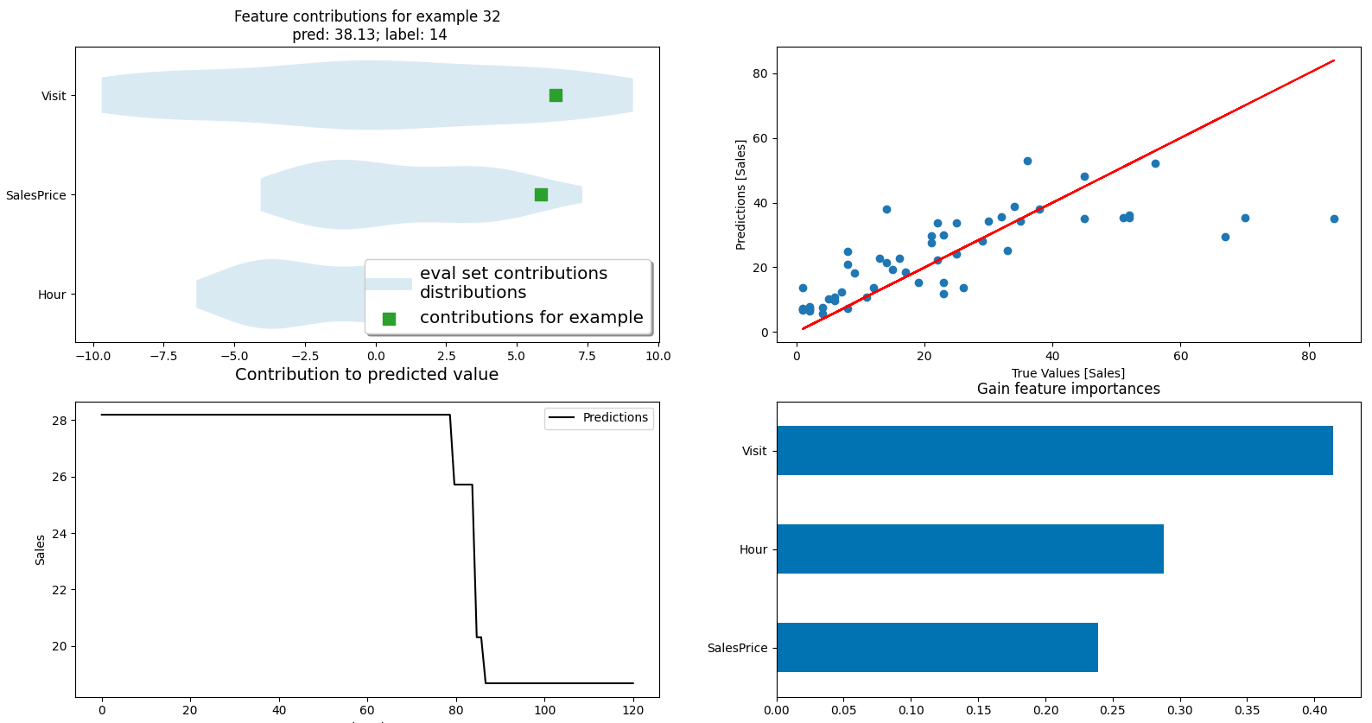
Prediction Results with only 3 Criterias

Slide 6
SOSCode Panic Button embedded in ID Cards for Emergency Situations in Hospitals
Sometimes things get hectic in hospitals. Babies may get abducted or doctors might be assaulted. We need a way to stop or deter this from happening.
We need a panic button which is quickly accessible and also quick to function that alerts security personnel to an emergency situation with the location data.
The microprocessor system should also be small and be embedded in the ID cards .
iBeacon beacons should be used for indoor positioning.
Battery lifetime currently isn’t a priority as it is a prototype project.

Slide 7
Methods & Tools
ESP32 Development board which has both Wifi and Bluetooth modules embedded saves space.
PX402050 3.7 V battery is compatible with the ESP32 board’s operational voltage levels.
FC-75 battery charger makes the battery rechargeable through a micro USB interface.
iBeacon beacons periodically give out their major and minor numbers.
4 pin push button allows us to trigger the scan and alerting.
Arduino IDE allows the coding of the ESP-Vroom-32 chip.
Soldering station helps us connect all the components.
Espressif Inc.’s bluetooth and wifi libraries for Arduino IDE allowed the ESP32 to connect to the wifi in the setup part and scan and alert in the loop part of microprocessor programming.

Slide 8
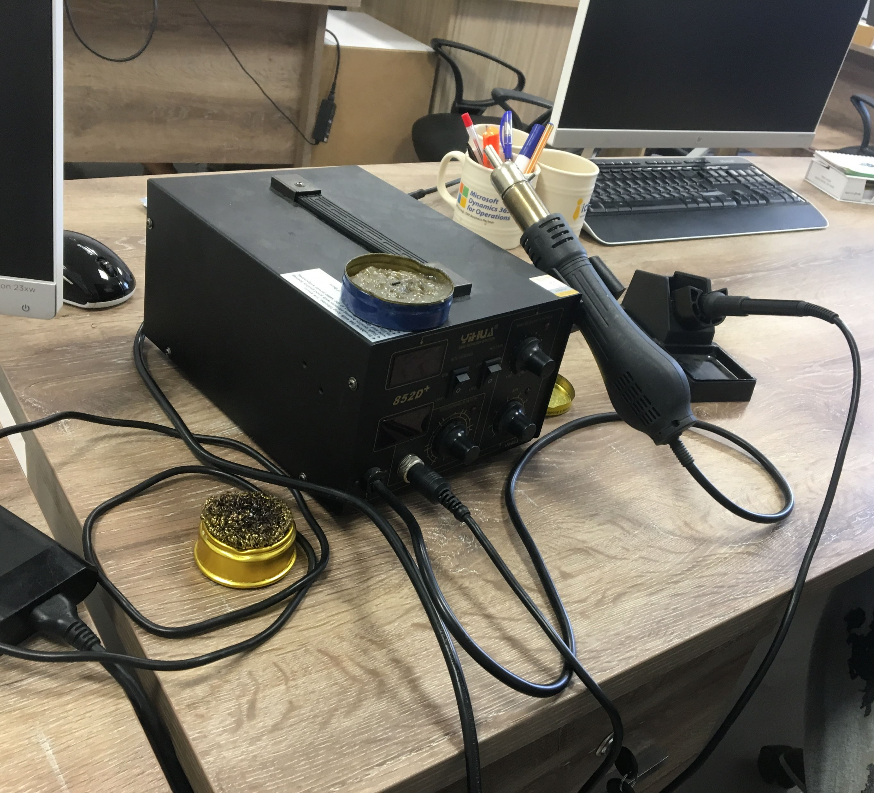
A soldering station consists of :
Soldering iron
Hot air gun
Power station and controls
Grease
Soldering tip cleaner

Slide 9
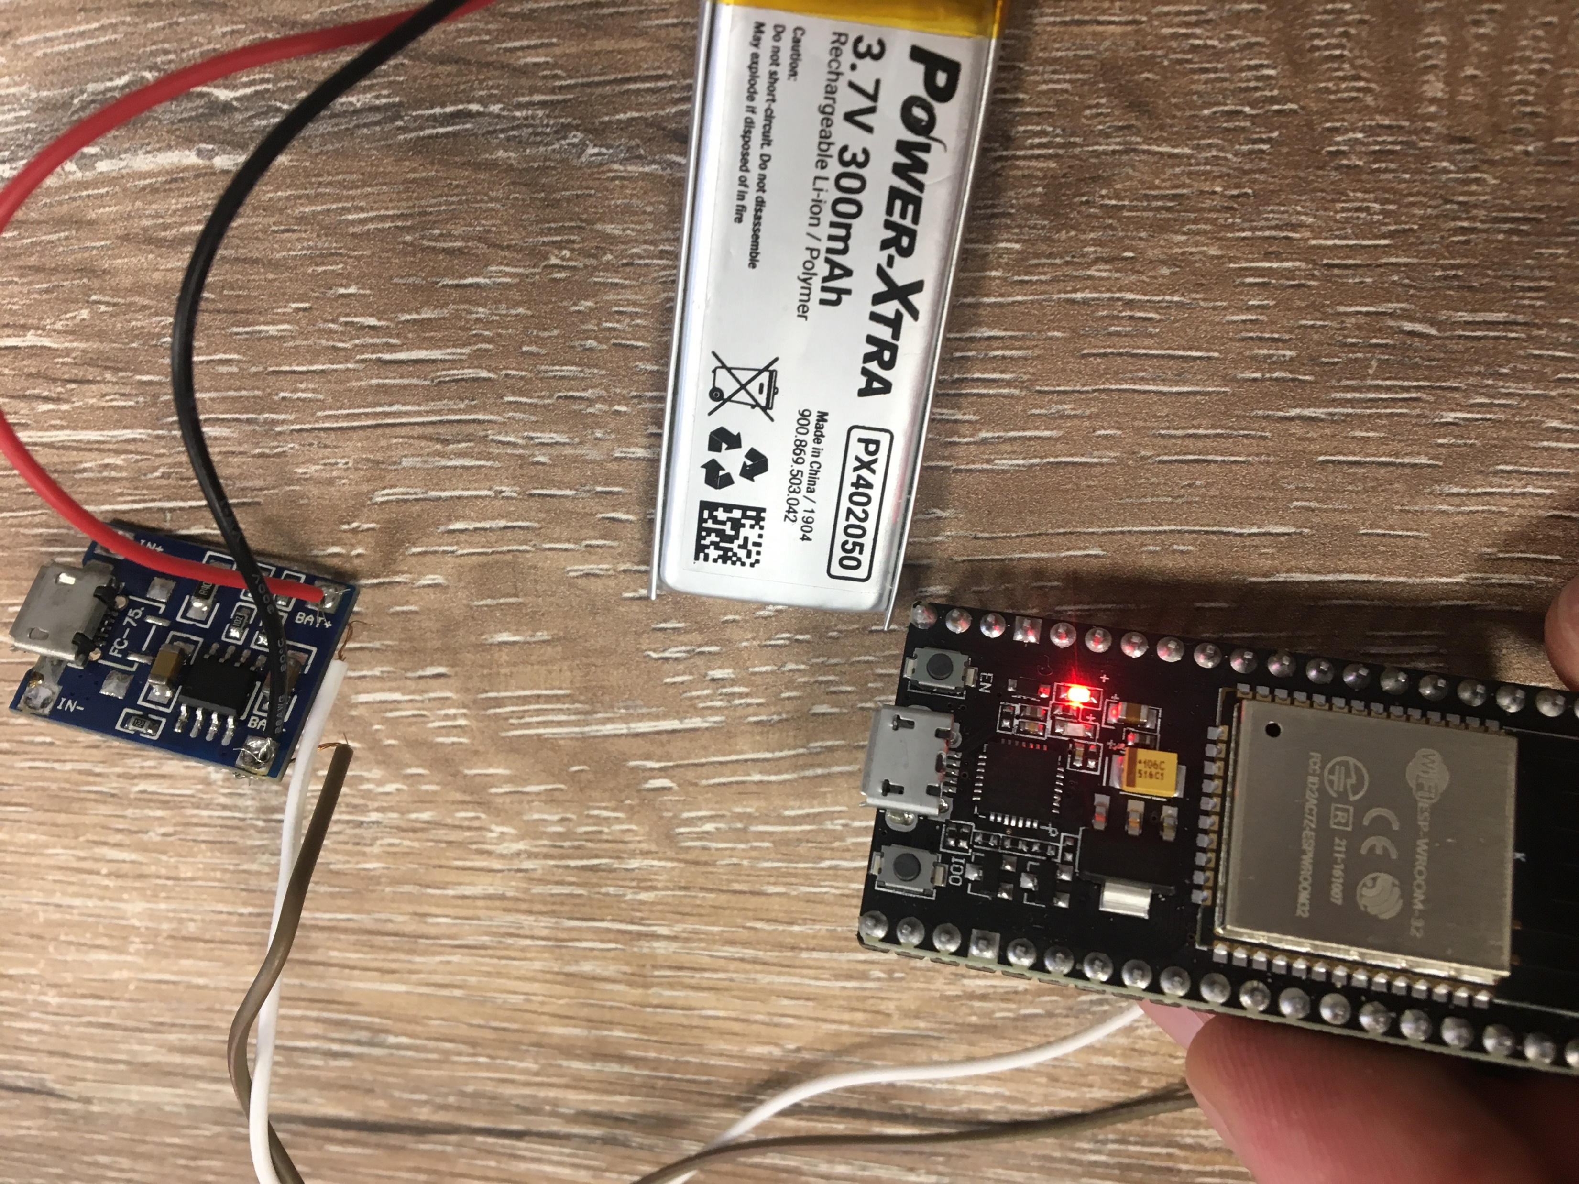
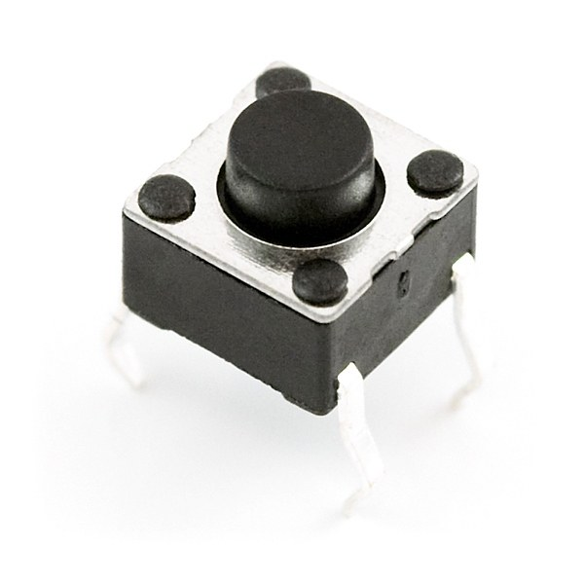
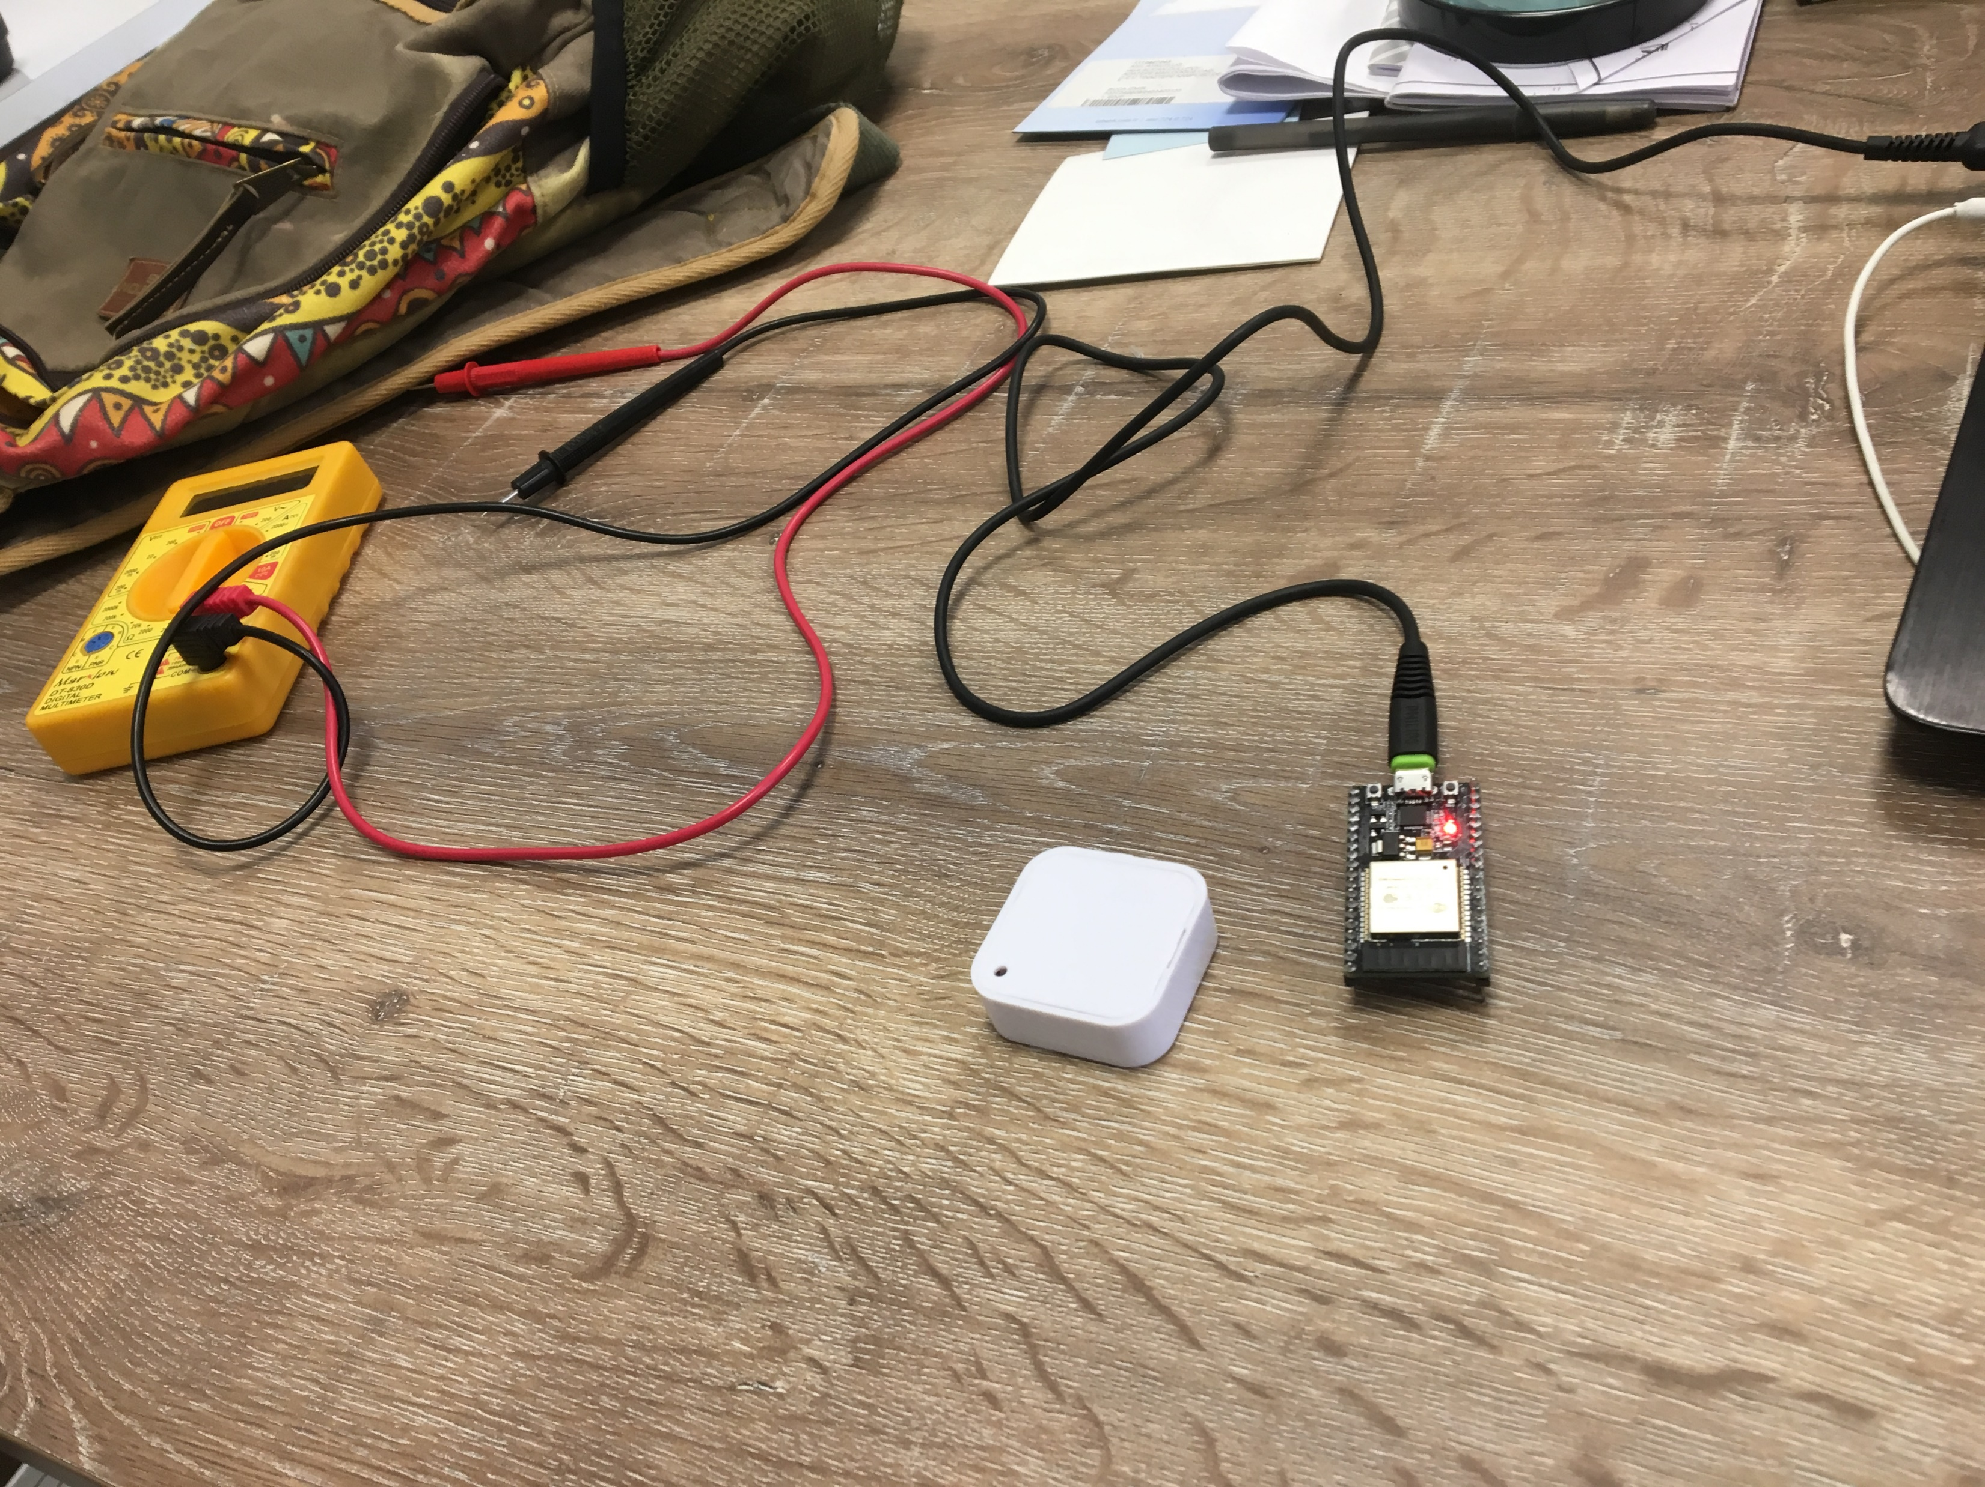
The microprocessor system consisted of:
3.7V 300 mAh Power-Xtra PX402050 Rechargeable Li-Ion / Polymer Battery
FC-75 Batter Charger
ESP32S Dual Mode Development Board with ESP-Vroom-32 chip
4 pin push button
iBeacon beacons

Slide 10
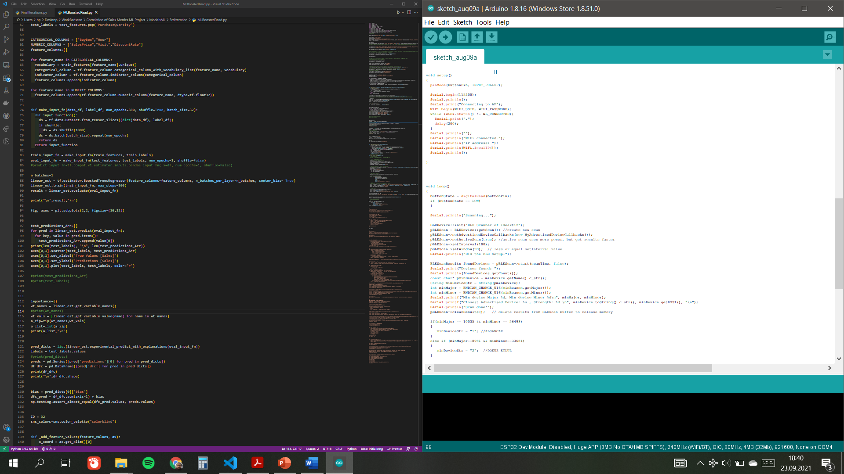

Slide 11
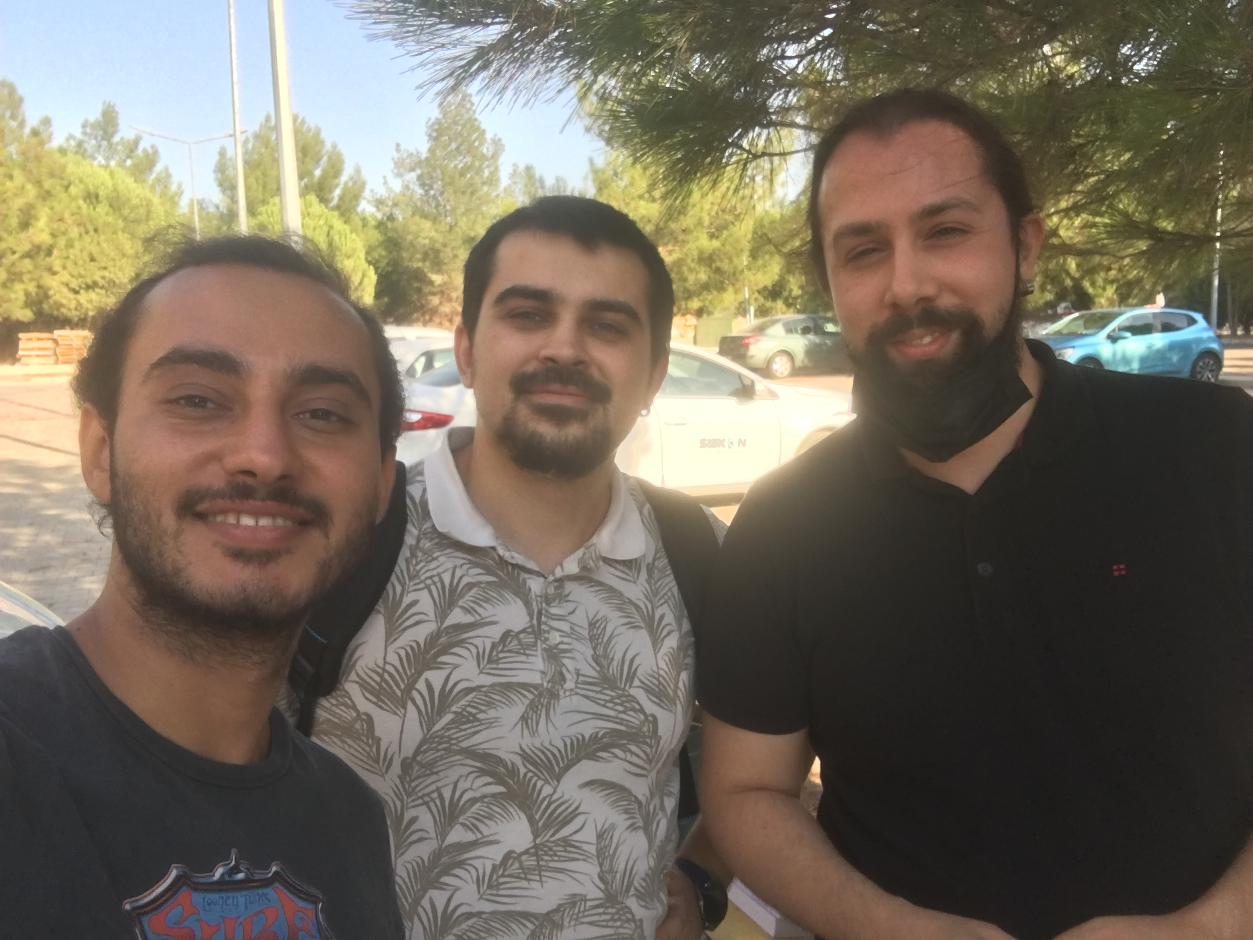
PROJ302
Ideaktif Danışmanlık & Yazılım LTD. ŞTI.
Machine Learning & Microprocessor Based System Design Internship
11.06.2021-13.08.2021

